Slide 1
Seminar on random walks on graphs
Lecture No. 2
Mille Gandelsman, 9.11.2009

Slide 2
Contents
Reversible and non-reversible Markov Chains.
Difficulty of sampling “simple to describe” distributions.
The Boolean cube.
The hard-core model.
The q-coloring problem.
MCMC and Gibbs samplers.
Fast convergence of Gibbs sampler for the Boolean cube.
Fast convergence of Gibbs sampler for random q-colorings.

Slide 3


Reminder
A Markov chain with state space is said to be irreducible if for all we have that .
A Markov chain with transition matrix is said to be aperiodic if for every there is an such that for every :
Every irreducible and aperiodic Markov chain has exactly one stationary distribution.

Slide 4

Reversible Markov Chains
Definition: let be a Markov chain with state space and transition matrix. A probability distribution on is said to be reversible for the chain (or for the transition matrix) if for all we have:
Definition: A Markov chain is said to be reversible if there exists a reversible distribution for it.

Slide 5

Reversible Markov Chains (cont.)
Theorem [HAG 6.1]: let be a Markov chain with state space and transition matrix . If is a reversible distribution for the chain, then it is also a stationary distribution.
Proof:

Slide 6



Example:
Random walk on undirected graph
Random walk on undirected graph denoted by is a Markov chain with state space: and a transition matrix defined by:
It is a reversible Markov chain, with reversible distribution:
Where:

Slide 7


Reversible Markov Chains (cont .)
Proof:
if and are neighbors:
Otherwise:

Slide 8

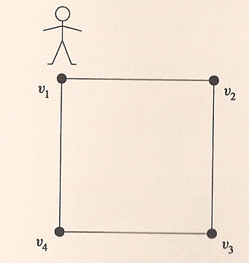
Non-reversible Markov chains
At each integer time, the walker moves one step clockwise with probability and one step counterclockwise with probability .
Hence, is (the only) stationary distribution.

Slide 9
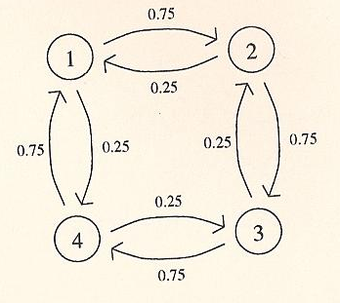

Non-reversible Markov chains ( cont.)
The transition graph is:
According to the above theorem it is enough to show that is not reversible, to conclude that the chain is not reversible. Indeed:

Slide 10
Examples of distributions we would like to sample
Boolean cube.
The hard-core model.
Q-coloring.

Slide 11
The Boolean cube
dimensional cube is regular graph with vertices.
Each vertex, therefore, can be viewed as tuple of -s and -s.
At each step we pick one of the possible directions and :
  With probability : move in that direction.
  With probability : stay in place.
For instance:

Slide 12
The Boolean cube (cont.)
What is the stationary distribution?
How do we sample?

Slide 13

The hard-core model
Given a graph each assignment of 0-s and 1-s to the vertices is called a configuration.
A configuration is called feasible if no two adjacent vertices both take value 1.
Previously also referred to as independent set.
We define a probability measure on as follows, for :
Where is the total number of feasible configurations.

Slide 14
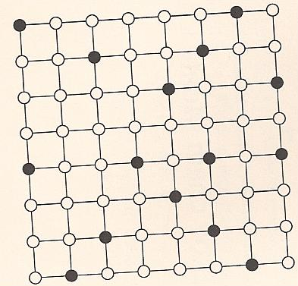
The hard-core model (cont.)
An example of a random configuration chosen according to in the case where is the a square grid 8*8:

Slide 15
How to sample these distributions?
Boolean cube - easy to sample.
Hard-core model:
There are relatively few feasible configurations, meaning that counting all of them is not much worse than sampling.
But: , which means that even in the simple case of the chess board, the problem is computationally difficult.
Same problem for q-coloring…

Slide 16

Q-colorings problem
For a graph and an integer we define a q-coloring of the graph as an assignment of values from with the property that no 2 adjacent vertices have the same value (color).
A random q-coloring for is a q-coloring chosen uniformly at random from the set of possible q-colorings for .
Denote the corresponding probability distribution on by .

Slide 17
Markov chain Monte Carlo
Given a probability distribution that we want to simulate, suppose we can construct a MC , whose stationary distribution is .
If we run the chain with arbitrary initial distribution, then the distribution of the chain at time converges to as .
The approximation can be made arbitrary good by picking the running time large.
How can it be easier to construct a MC with the desired property than to construct a random variable with distribution directly ?
… It can ! (based on an approximation).

Slide 18
MCMC for the hard-core model
Let us define a MC whose state space is given by: , with the following transition mechanism - at each integer time , we do as follows:
  Pick a vertex uniformly at random.
  With probability : if all the neighbors of take the value 0 in then let: Otherwise:
  For all vertices other than :

Slide 19
MCMC for the hard-core model (cont.)
In order to verify that this MC converges to:
we need to show that:
  It’s irreducible.
  It’s aperiodic.
  is indeed the stationary distribution.
We will use the theorem proved earlier and show that is reversible.

Slide 20




MCMC for the hard-core model (cont.)
Denote by the transition probability from state to .
We need to show that: for any 2 feasible configurations.
Denote by the number of vertices in which and differ:
  Case no.1:
  Case no.2:
  Case no.3:
  because all neighbors of must take the value 0 in both and - otherwise one of the configurations will not be feasible.

Slide 21
MCMC for the hard-core model – summary
If we now run the chain for a long time , starting with an arbitrary configuration, and output then we get a random configuration whose distribution is approximately

Slide 22
MCMC and Gibbs Samplers
Note: We found a distribution that is reversible, though it is only required that it will be stationary.
This is often the case because it is an easy way to find a stationary distribution.
The above algorithm is an example of a special class of MCMC algorithms known Gibbs Samplers.

Slide 23
Gibbs sampler
A Gibbs sampler is a MC which simulates probability distributions on state spaces of the form where and are finite sets.
The transition mechanism of this MC at each integer time does the following:
  Pick a vertex uniformly at random.
  Pick according to the conditional distribution of the value at given that all other vertices take values according to
  Let for all vertices except .

